Slide 1

Rethinking Church Membership
Acts 9.26-31

Slide 2
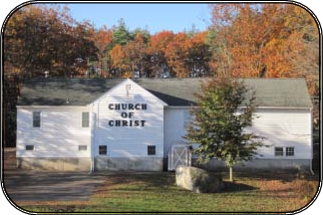
What Does It Mean to Be Apart of a Local Church?

Slide 3

The Meaning of Local
Church Membership
Creating a refuge from the harshness of the world.
Gaining the companionship of coworkers who labor beside you.
Giving and receiving the protection that comes from accountability.

Slide 4
A local church is designed to
be an extension of Jesus!

